Slide 1
EUROCORPS
La UE y la OTAN: Condenadas a entenderse
Toledo, 12 Junio 2019
A FORCE FOR THE EUROPEAN UNION AND NATO
General de División Fernando García Blázquez
Jefe de Estado Mayor del EUROCUERPO

Slide 2
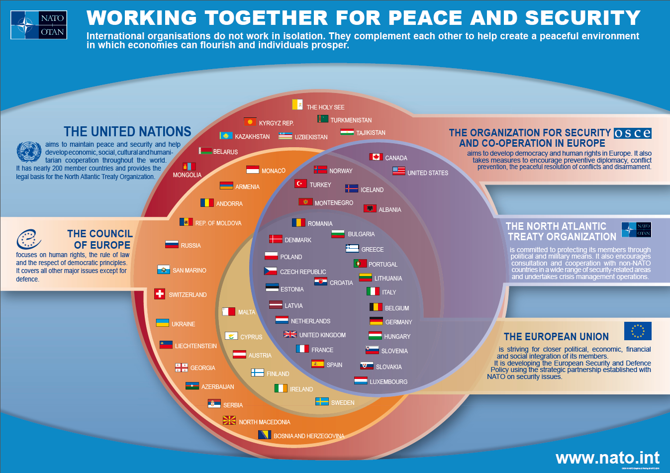
NATO & EU Members

Slide 3
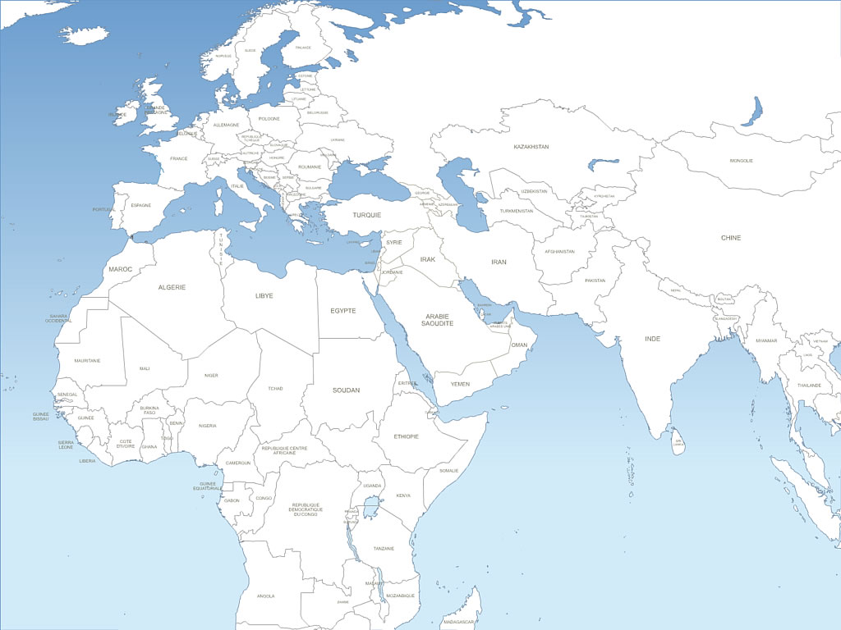
The Strategic Context
A Call for Concomitant Deterrence and Intervention facing a 360° hybrid threat
Western Europe
1- Active jihadist transnational networks
2- Massive migrant flows from crisis areas
Afghanistan: rebirth of Taleban networks + rear base of other jihadist organizations
1- Opportunity for Jihadists Sanctuaries
2- Providing capabilities to other zones
3- Opportunities to ‘re-conquer’ the country







Failed States Hosting Jihadists Sanctuaries:
1- Destabilizing the sub-continent thus provoking massive migration flows
2- Exporting terrorism on the European Soil
3- Attacking European interests in the sub-continent
Syrian / Iraqi Conflict: challenging the central power
1- Opportunity for Jihadists Sanctuaries
2- Providing capabilities to other zones
3- Exporting terrorism on the European soil
Notes:
Depicting the complexity of the European surroundings in terms of potential threats.
Back to high intensity symmetric warfare: re-emergence of the “Russian bear”. In a quite offensive manner, Russia is struggling to preserve and even extend its area of influence. It is currently based on robust STRATCOM campaigns as well as on diplomatic singularity. Large scale military operations at the Eastern border of the European Union are not foreseeable in a close future.
As a consequence, a preventive approach is now privileged, mainly under the initiative of NATO which aims at establishing the military conditions for credible deterrence. This is concretized throughout the NCS adaptation requiring further contribution from the Nations in order to reinforce the C2 construct thus enabled to cope with a major high intensity conflict in Europe. I shall come back to this point in a moment.
Fundamental terrorism (mostly originated from the Middle East but now spreading in Africa): enduring threat to be countered inside and outside the European soil. The main problem is that the local security forces are neither sufficiently trained nor efficiently equipped / organized to fight against armed terrorist groups.
Therefore, there is a necessity to think about forward defensive operations meaning deployment of forces at strategic distance. This can be translated in twofold missions: disruption of terrorist networks and operational military assistance to local security forces. Military assistance naturally includes military training programs pending on the status of equipment, knowledge, education and preparedness of local security forces.
Migration: containment is at stake. In Africa , the low level of development will hamper this young population to have acceptable conditions of life as far as most of the African countries are not able to support this from an economic point of view. Political instability or fragility comes alongside with the previous deficiency. Therefore, it is nowadays assessed that more than 10 million Africans could be appealed for seeking “opportunities” for more wealth in Europe. Demographic imbalance then becomes a high risk with all its consequences on the cohesion of our societies.
Hence, European comprehensive support to local governance becomes at stake. The military have not a primary role to play in such a framework. However, considering the paramount importance of internal stability in Africa, training missions to the local security forces keep a large significance. Furthermore, cohesion and coherence amongst the Nations will noticeably need strengthening. Multinational military structures in lead of operations in Africa could be a visible capstone to this reinforced overall consistency.

Slide 4
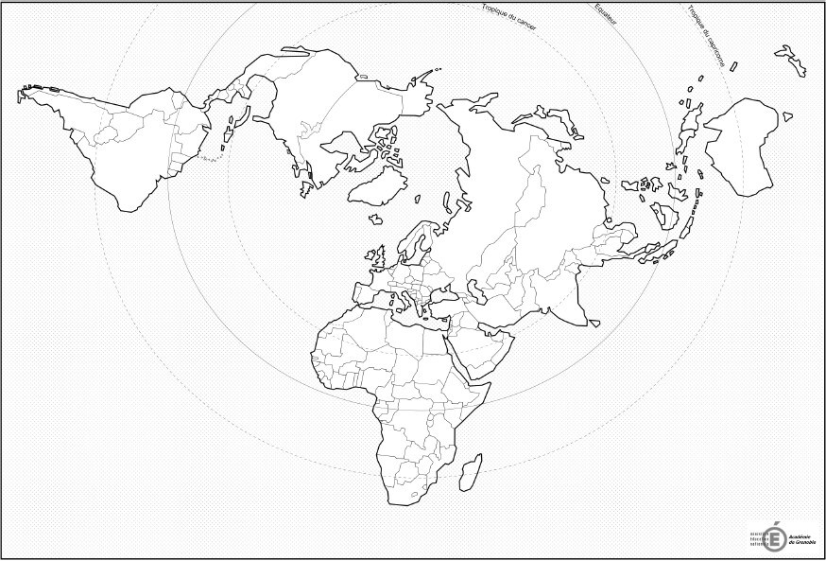

Sharing the European Strategic Area of Interest
Transatlantic Link
EU / AU Link
EU Primary AoI
?
NATO Primary AoI
Major Crisis Affecting Security in Europe
Potential Major Crisis Affecting Security in Europe
Migrants Flows
Fundamentalists back from ME and African battlefields
4

Slide 5

Part of the HRF (L) HQ community - NATO Force Structure

Slide 6
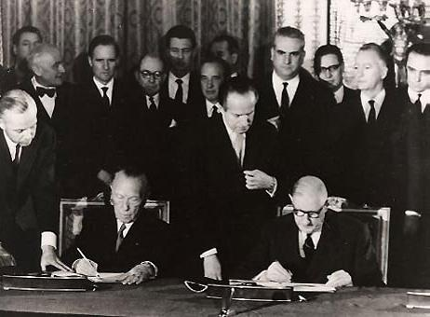
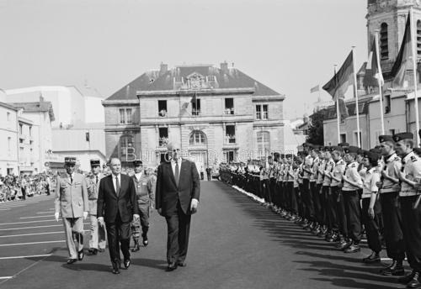
A GERMAN-FRENCH INITIATIVE
… time for reconciliation
May 1992 – La Rochelle Report
In a new strategic context…
Promote European Security and Defence identity
Set-up conditions of a European partnership with the North Atlantic Alliance
1963: Élysée Treaty

Slide 7



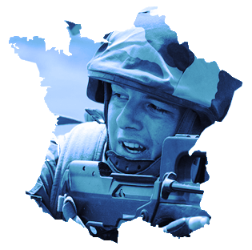







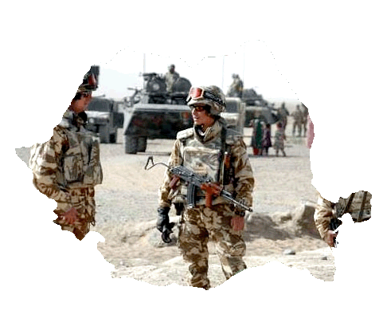
Eurocorps members
5 Framework Nations
5 Associated Nations
France
1992
Turkey
2002
Germany
1992
Greece
2002
Belgium
1993
Italy
2009
Spain
1994
Poland
2002
Luxembourg
1996
Romania
2015

Slide 8
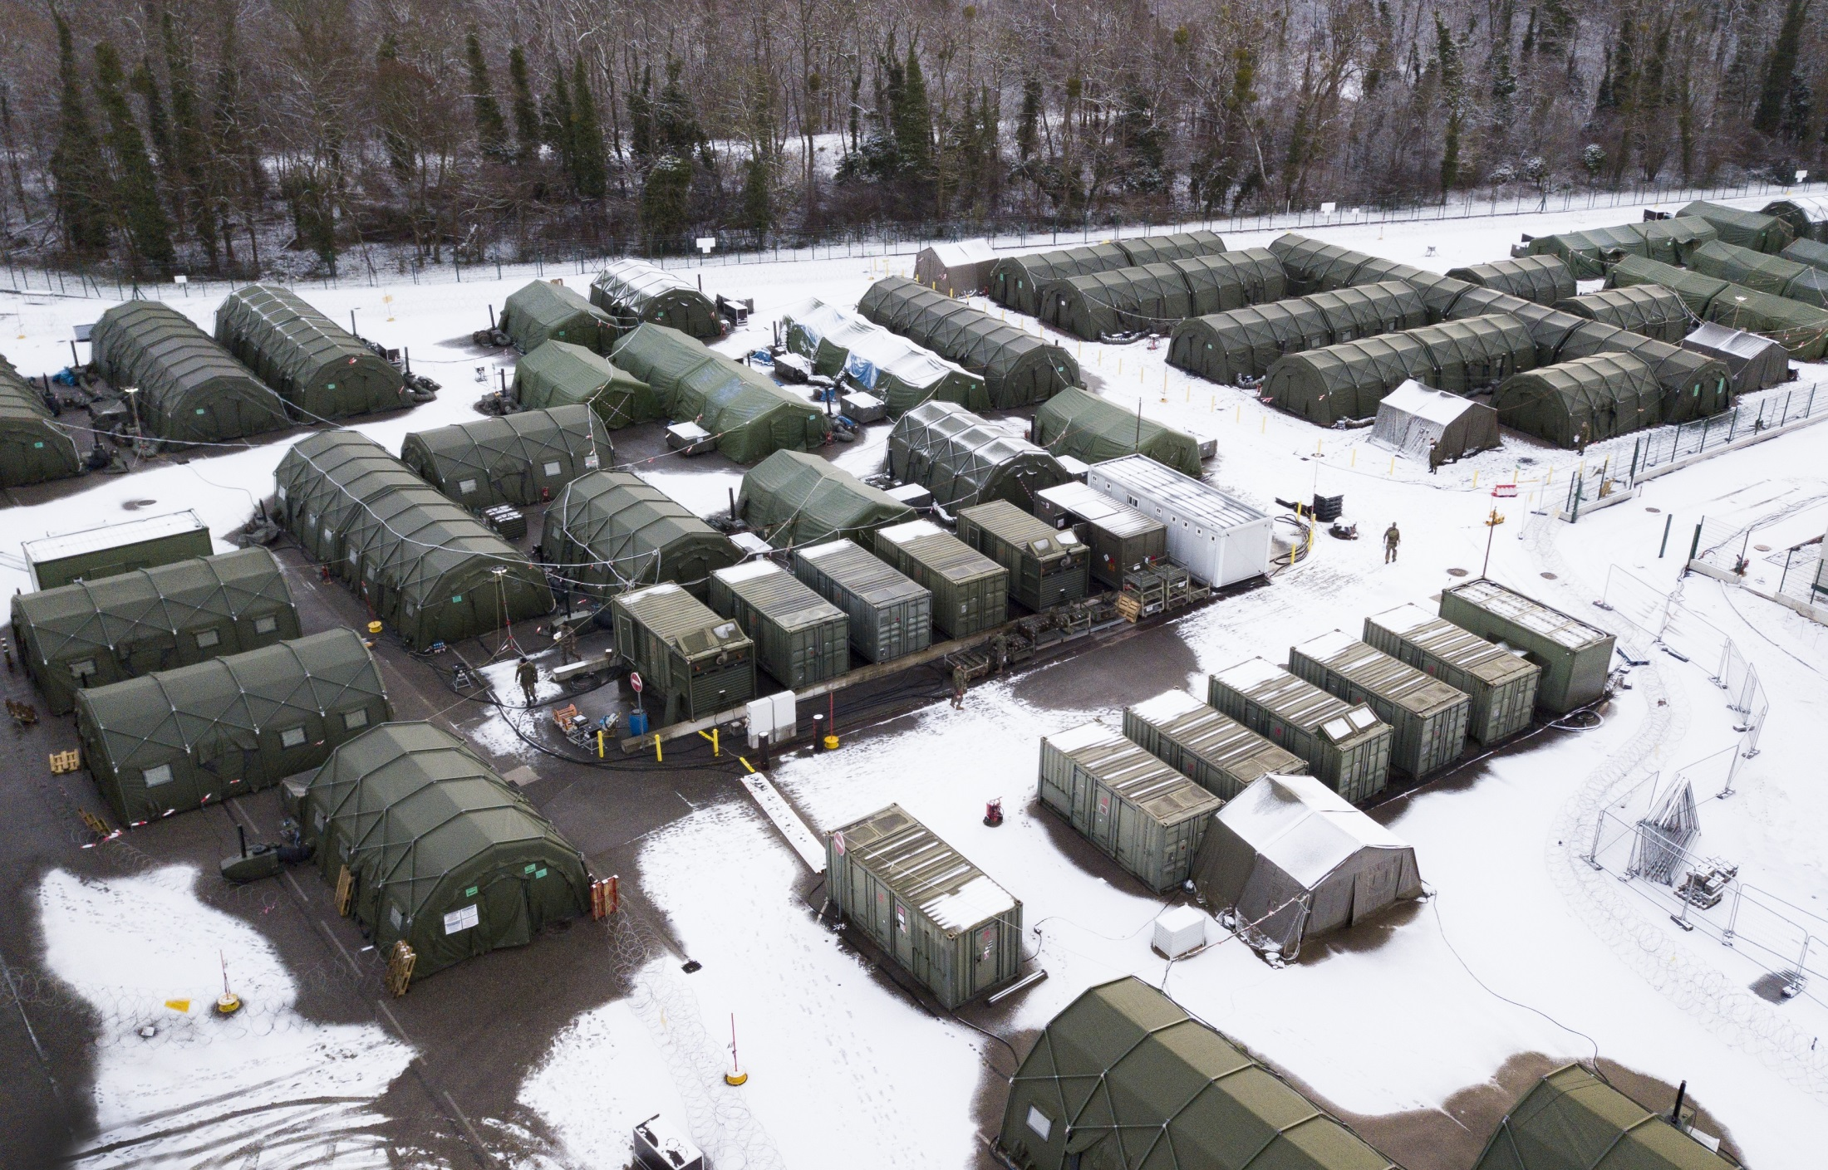

Slide 9
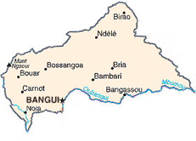
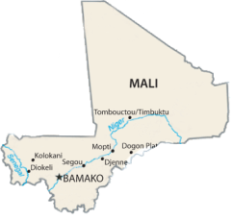

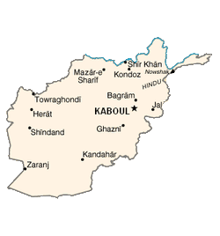


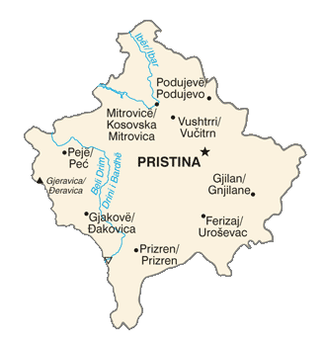

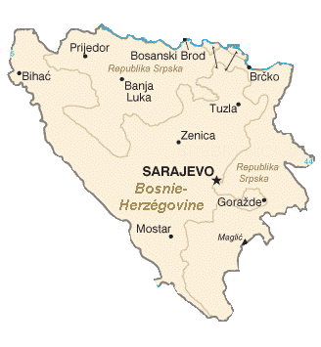





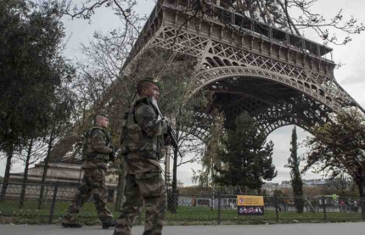
MISSIONS / deployments
The MOST COMMITTED
A unique LEGACY
2016 and 2017
2015
2012
2004-2005
Central African Republic
2000
1998
-2000
Mali
Afghanistan
Afghanistan
Standby
EUROPEAN BATTLEGROUP
Kosovo
2017/1
EUROPEAN BATTLEGROUP
2016-2
Bosnia- Herzegowina
NATO RESPONSE FORCE 15
2010
NATO RESPONSE FORCE 7
2006

Slide 10
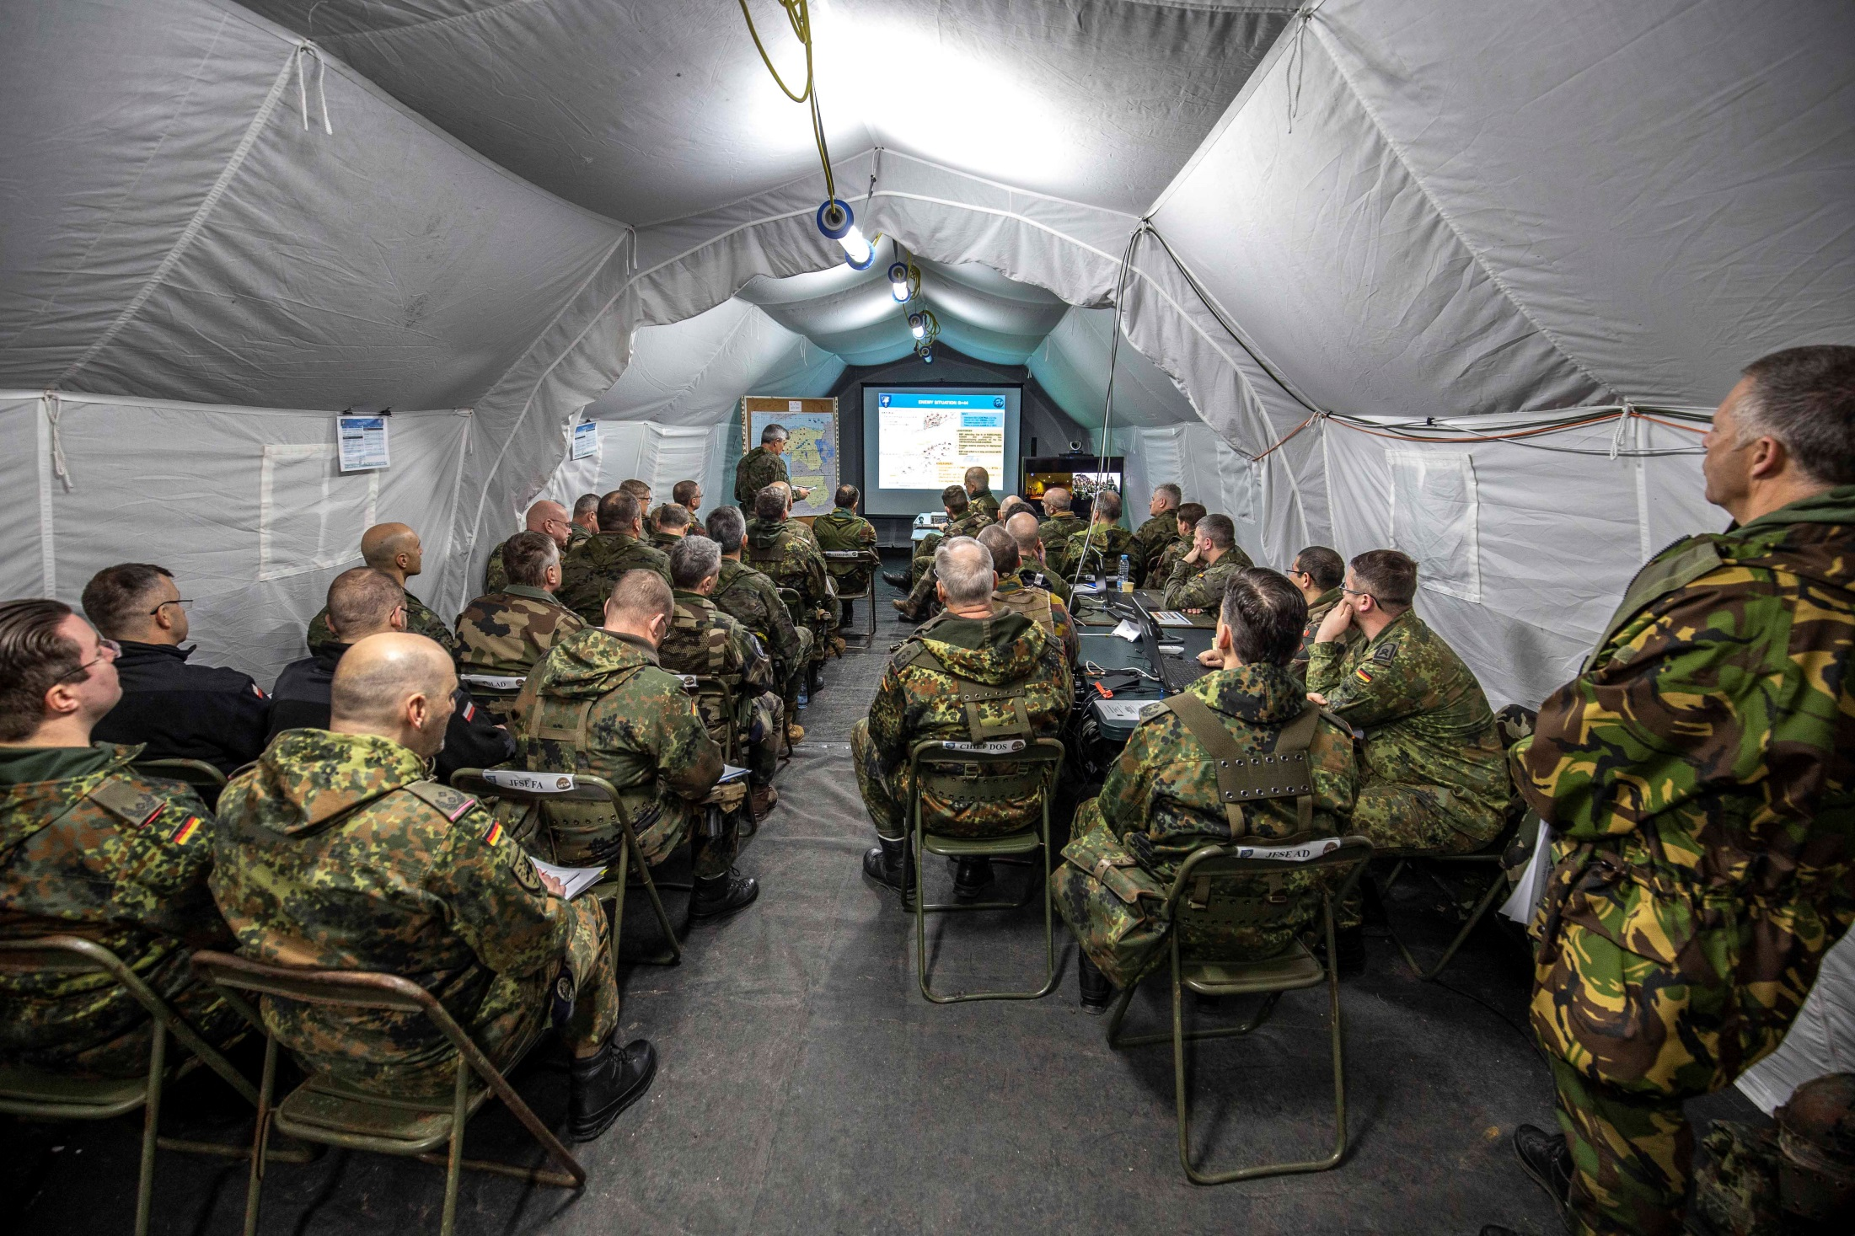

Slide 11
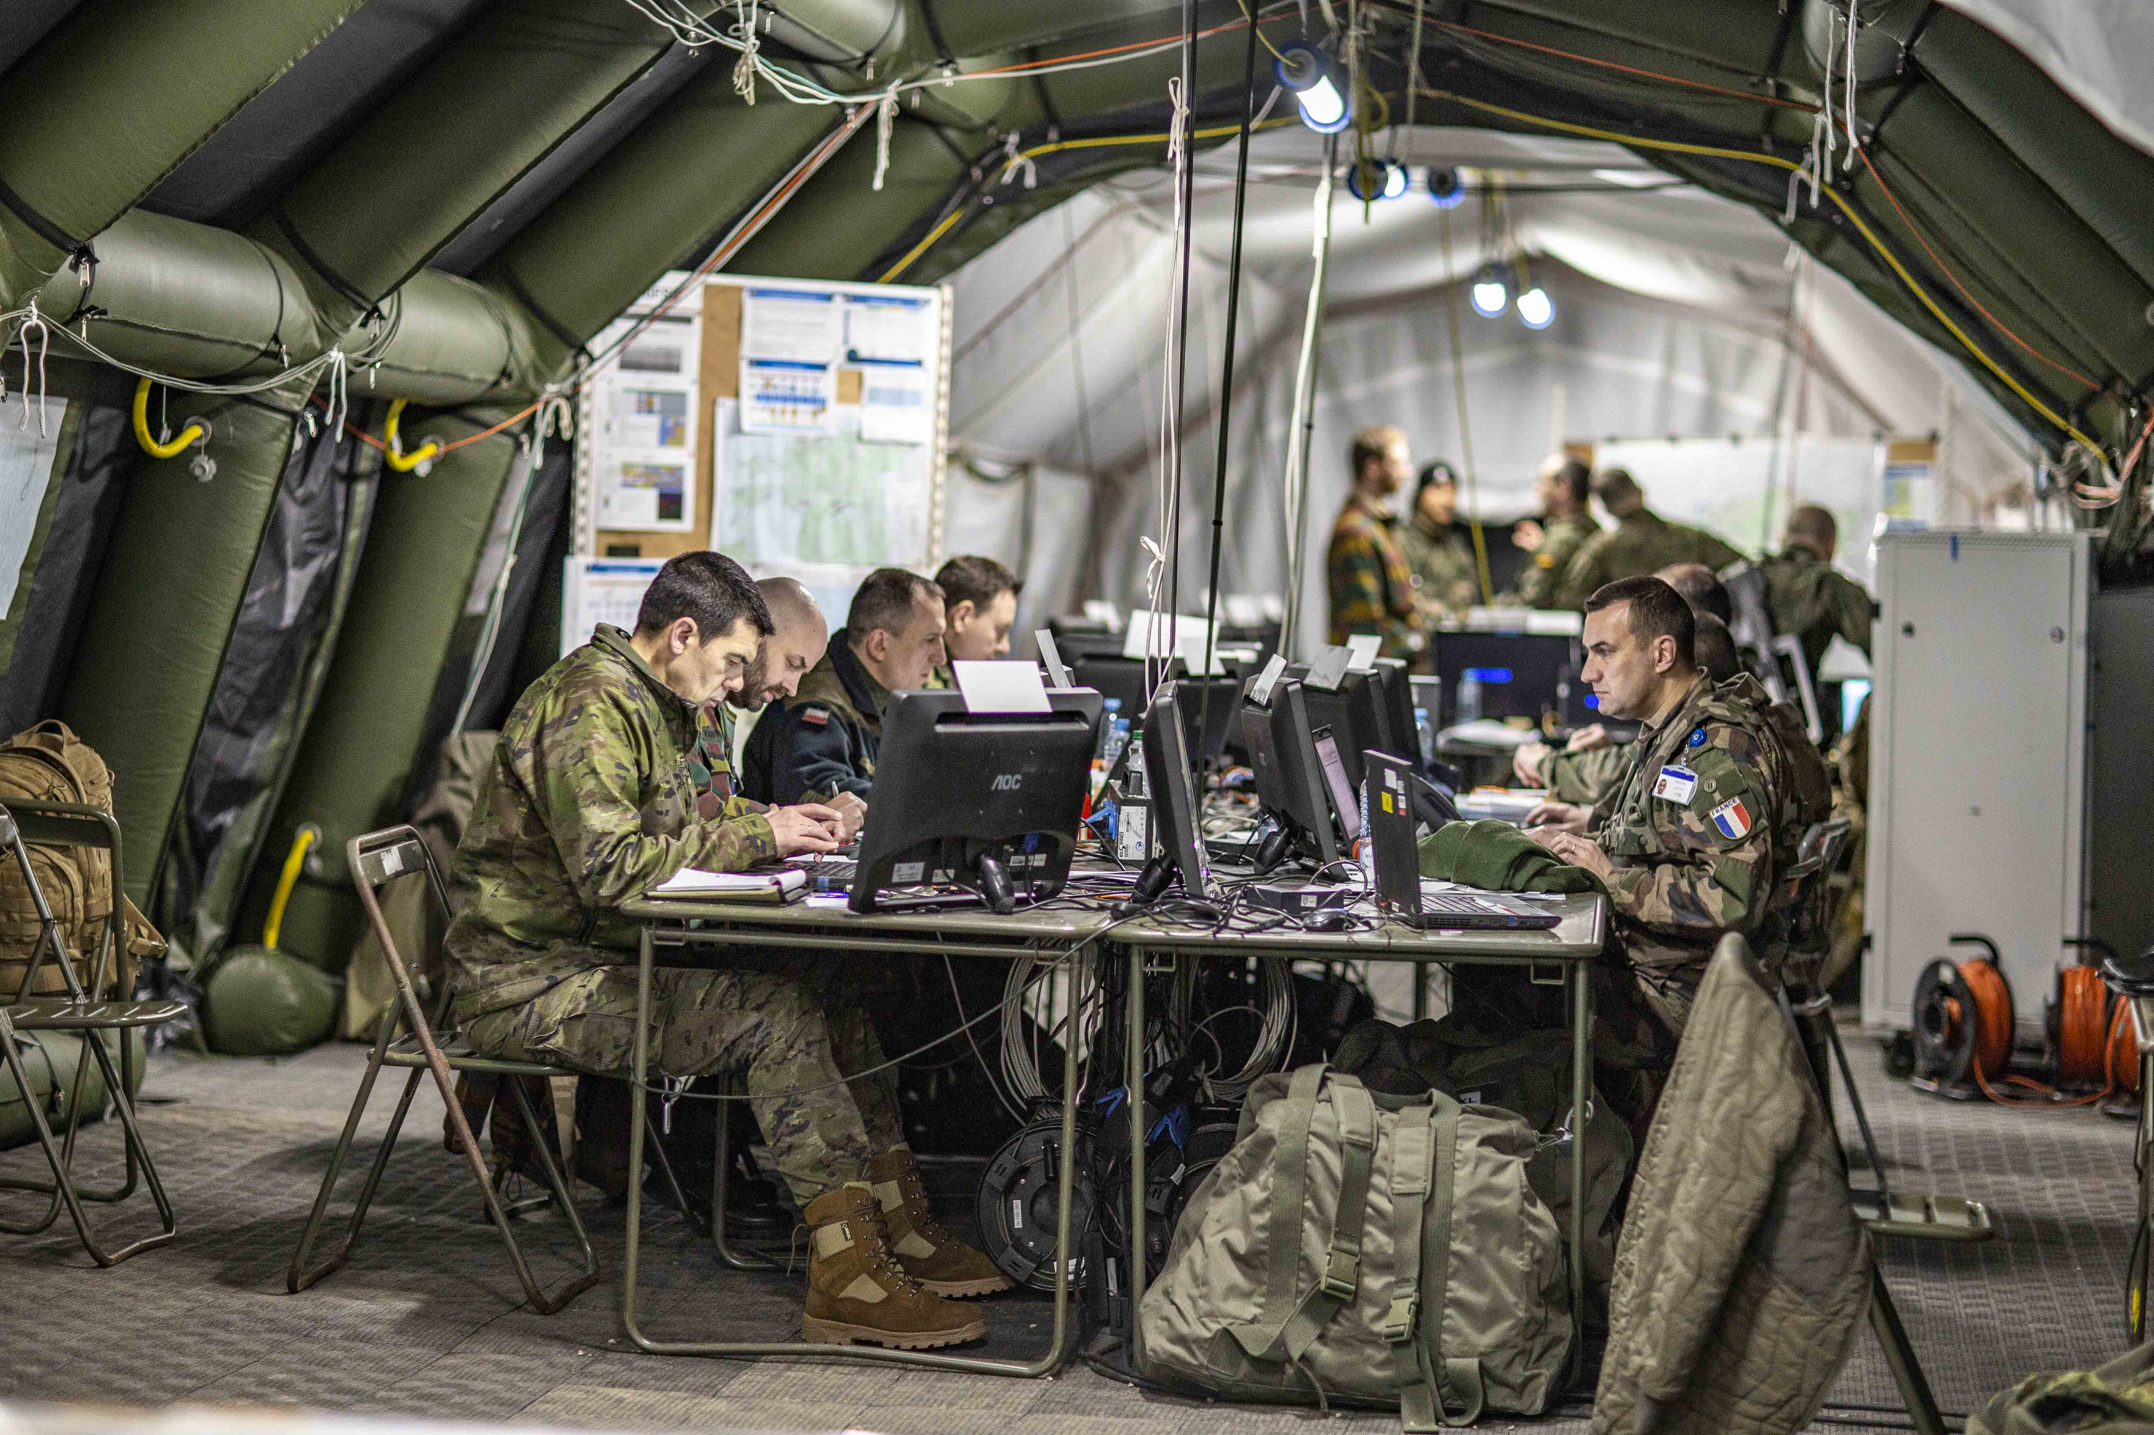

Slide 12
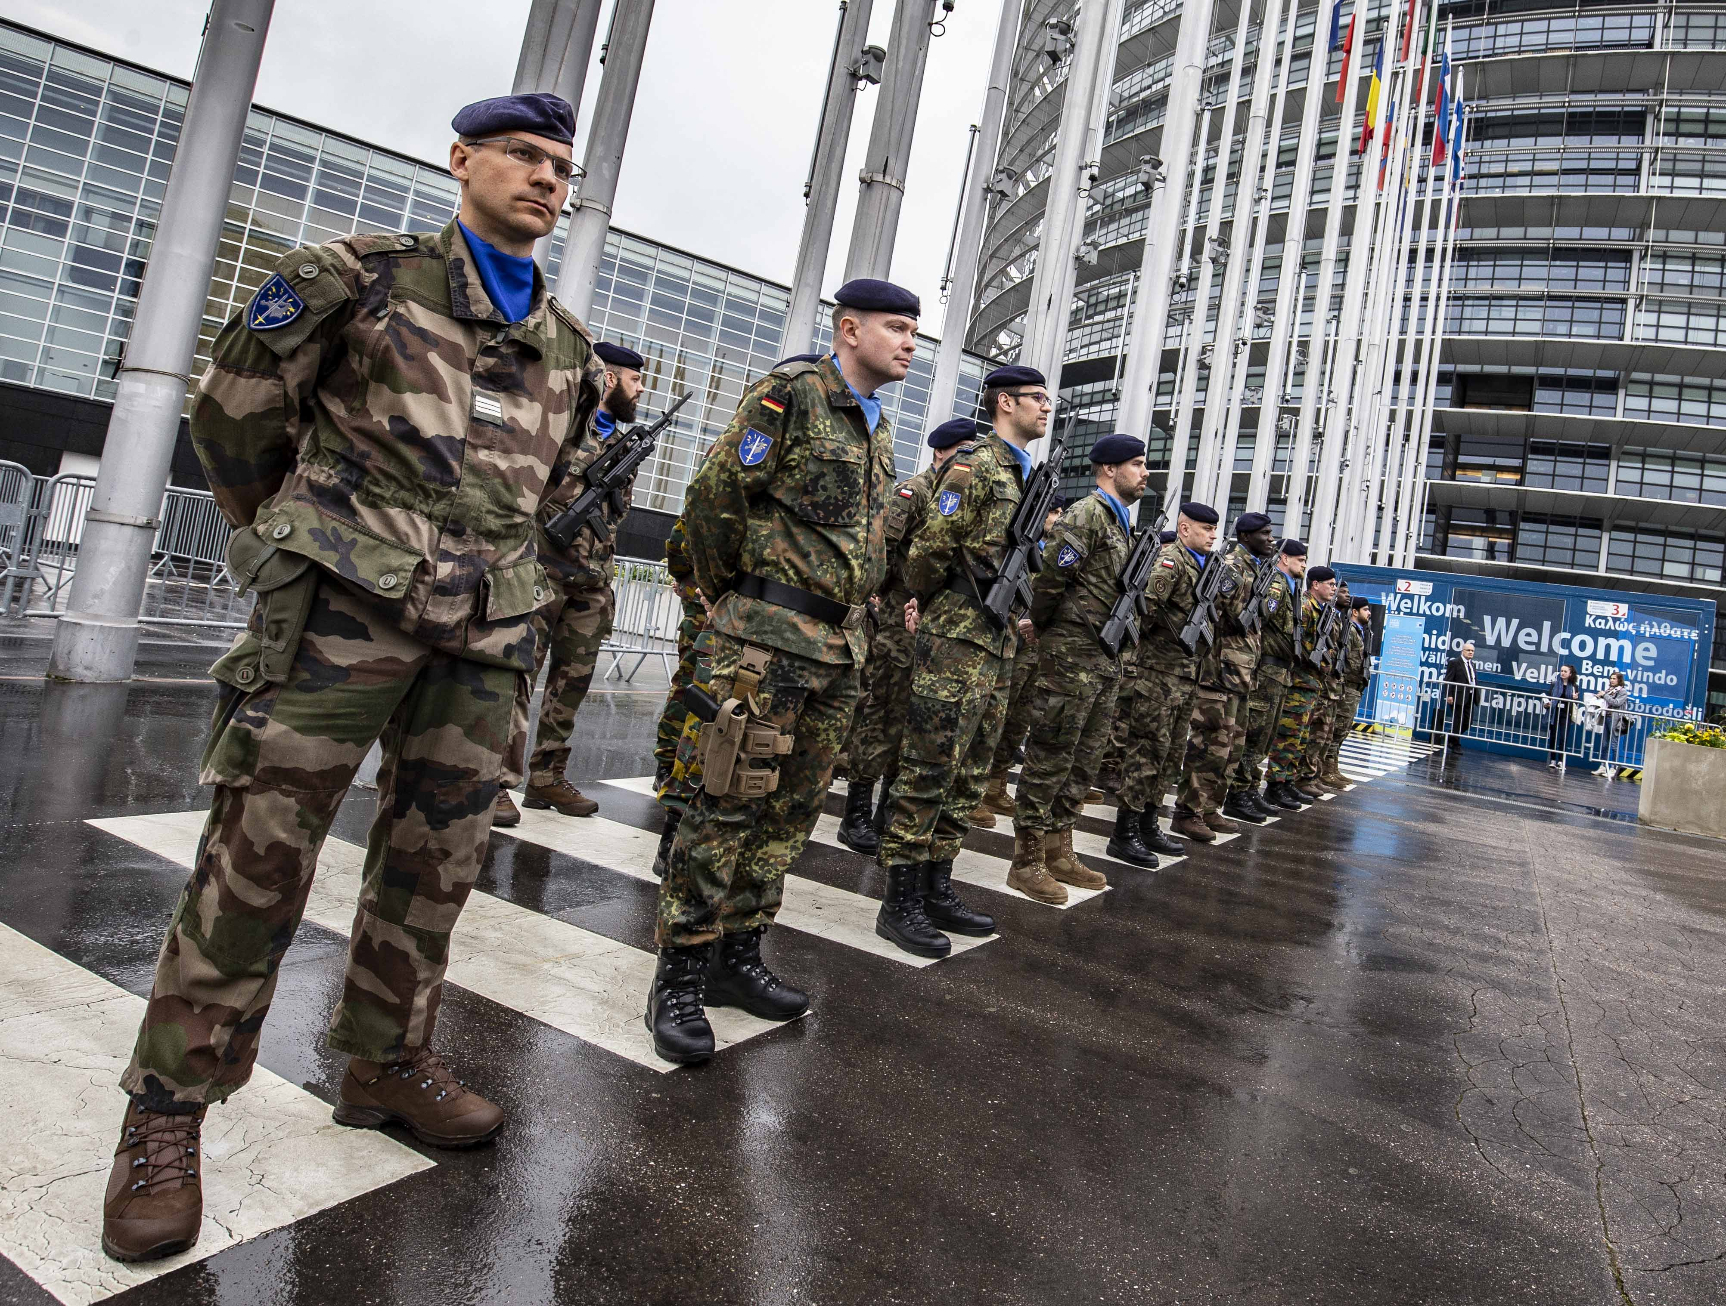

Slide 13



SUMMARY
A UNIQUE DUAL STATUS
HIGHLY OPERATIONAL
RAPIDLY DEPLOYABLE
EXPERIENCED EU AND NATO CERTIFIED
READY TO FACE FUTURE CHALLENGES
HIGH PAY BACK FOR THE NATIONS

Slide 14
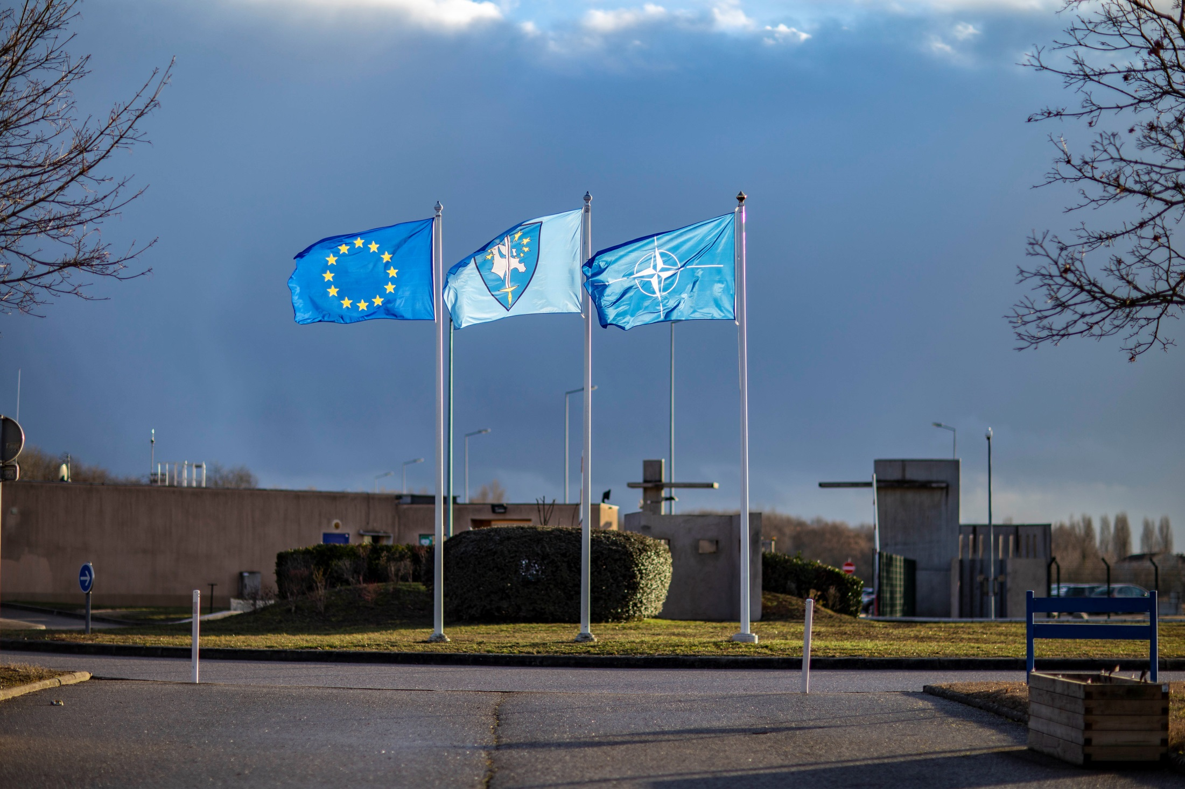
EUROCORPS
GOOD EXAMPLE
of
Mutual Understanding
for the
SECURITY and DEFENSE
of EUROPE

